Slide 1
Engineered by:
Khaleel Karim
Ivy Zeledon
Tiffany Vuong
Chrisentia Sutardji
Vijayapriya Ganesan
Consulted by:
Amrutha Ravikrishnan
Jacqueline Jones
Hermes

Slide 2
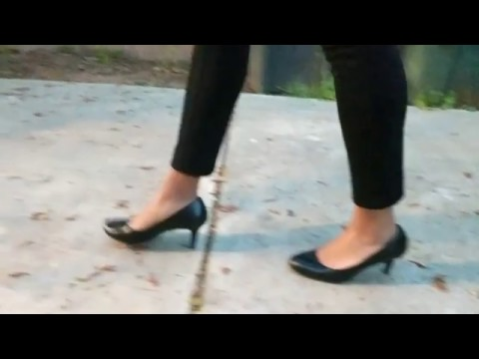
Video

Slide 3
Background
Over 5 million surgeries are performed each year in the U.S
Effects: numbness and difficulty walking depending on the surgery area: foot, ankle, brain, spinal cord and pelvic surgery
Concern: Serious injuries and extended recovery time

Slide 4
Solution: Hermes
Smart shoe designed for: an affordable price, User friendly interface
Increase Patient Mobility and Confidence
Reduce injuries and recovery time
Help patient take every step to a proper recovery
Place Hermes in reach of patients, one step at a time

Slide 5
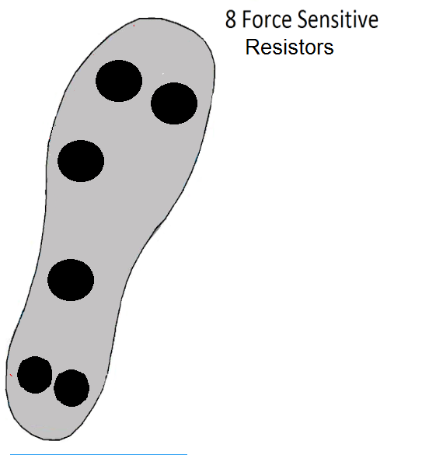
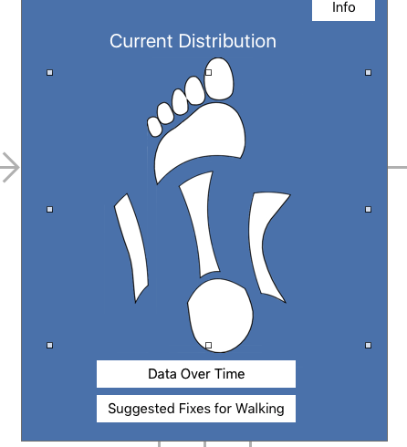
Sensor Distribution

Slide 6
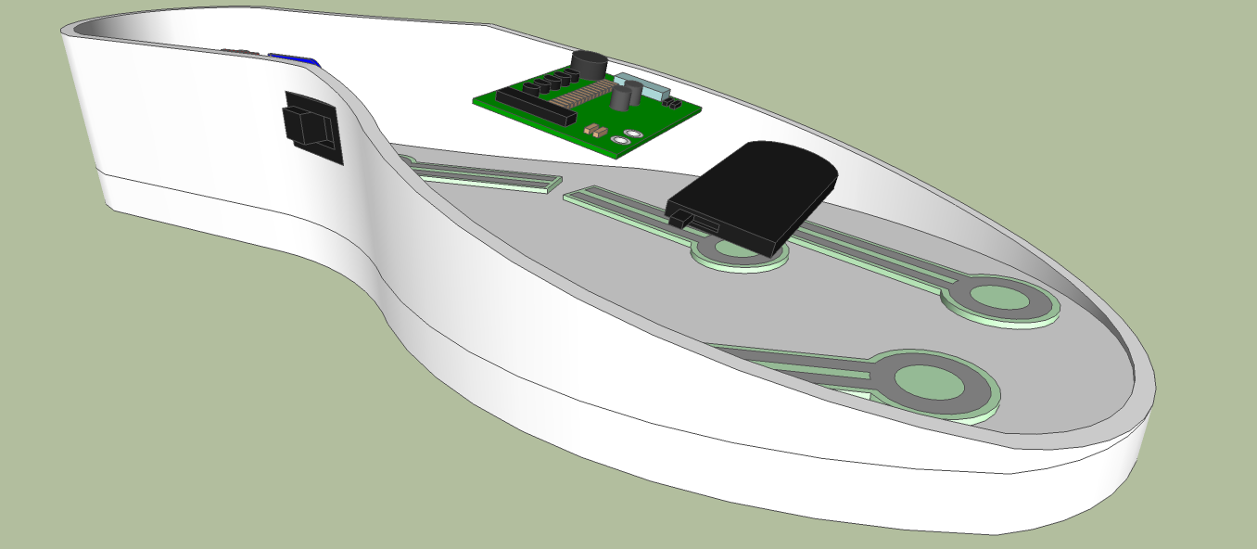
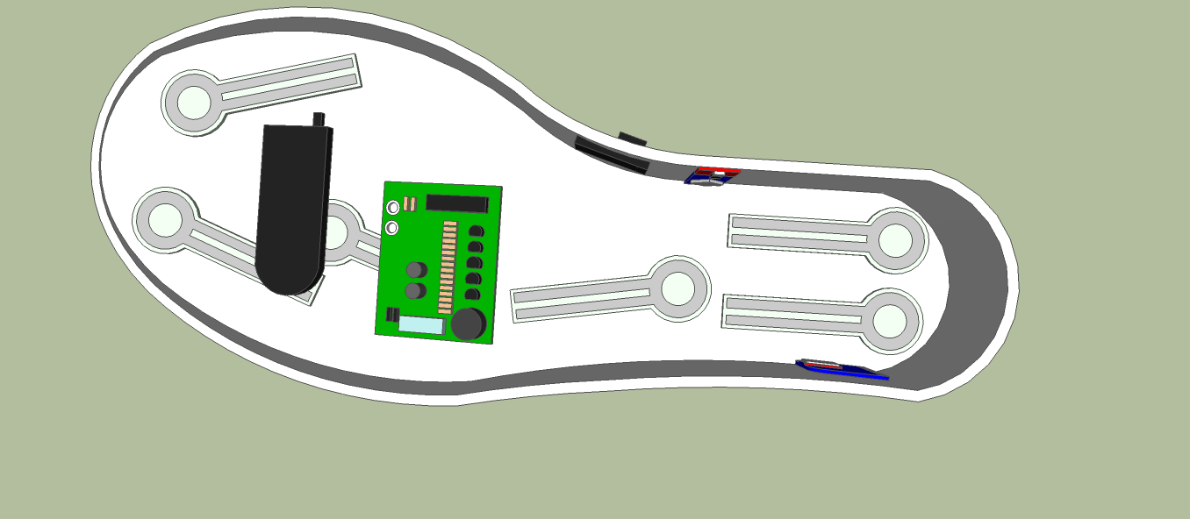
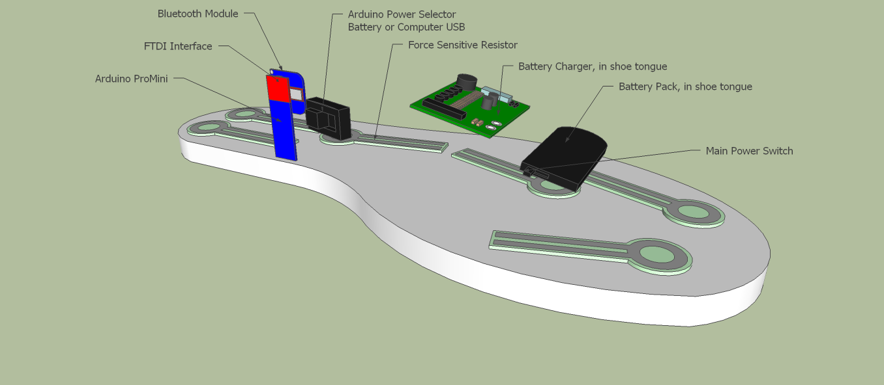
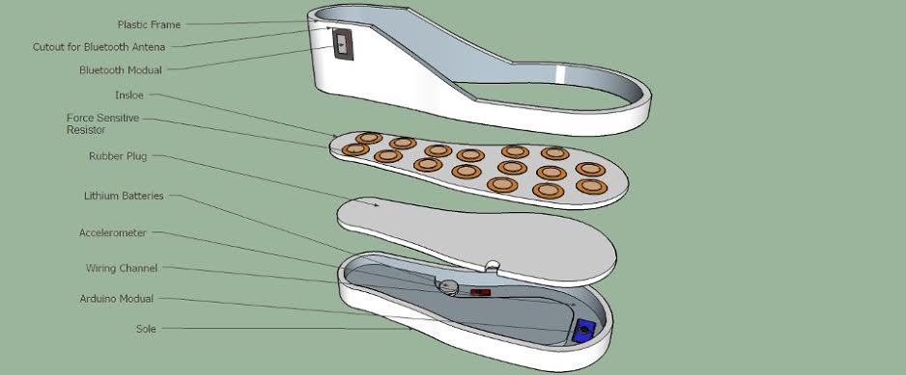
Blueprint/Schematics

Slide 7
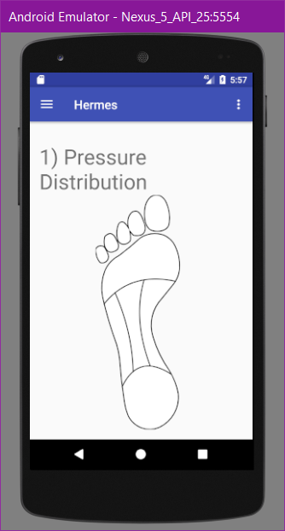
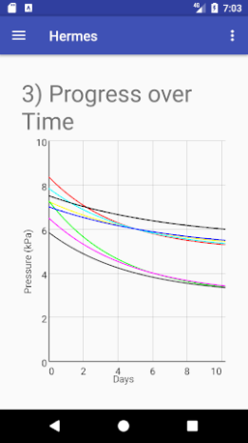
Application
1. Patient wears Hermes smart shoe
2. User opens application on iOS or Android device
3. Application detects pressure distribution
4. User rectifies steps and monitors progress

Slide 8
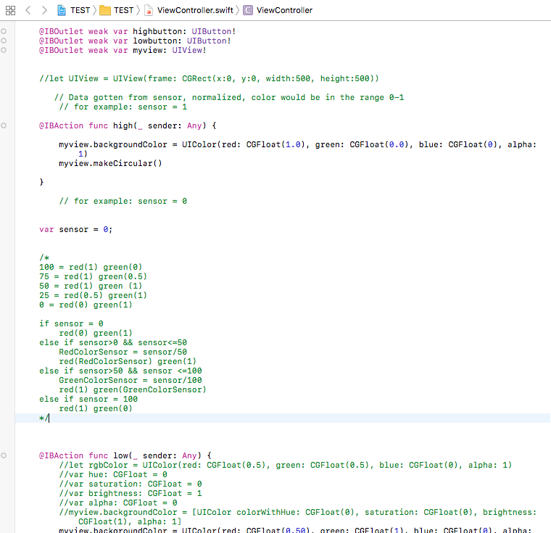
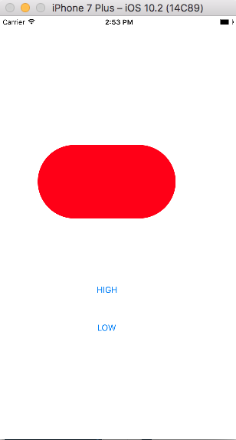
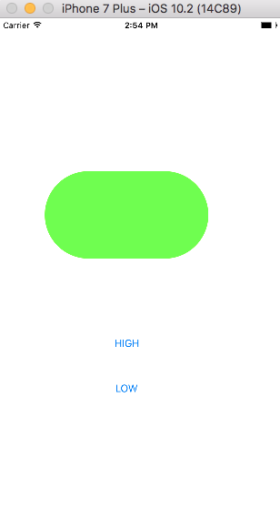
RGB coding process

Slide 9
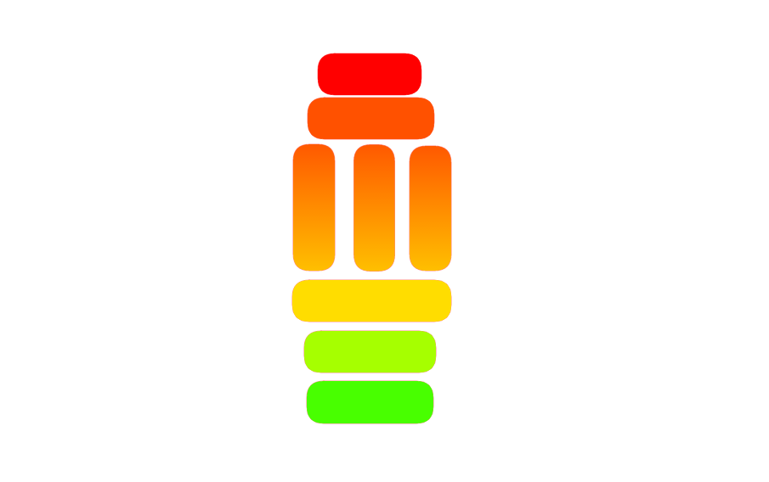

Slide 10
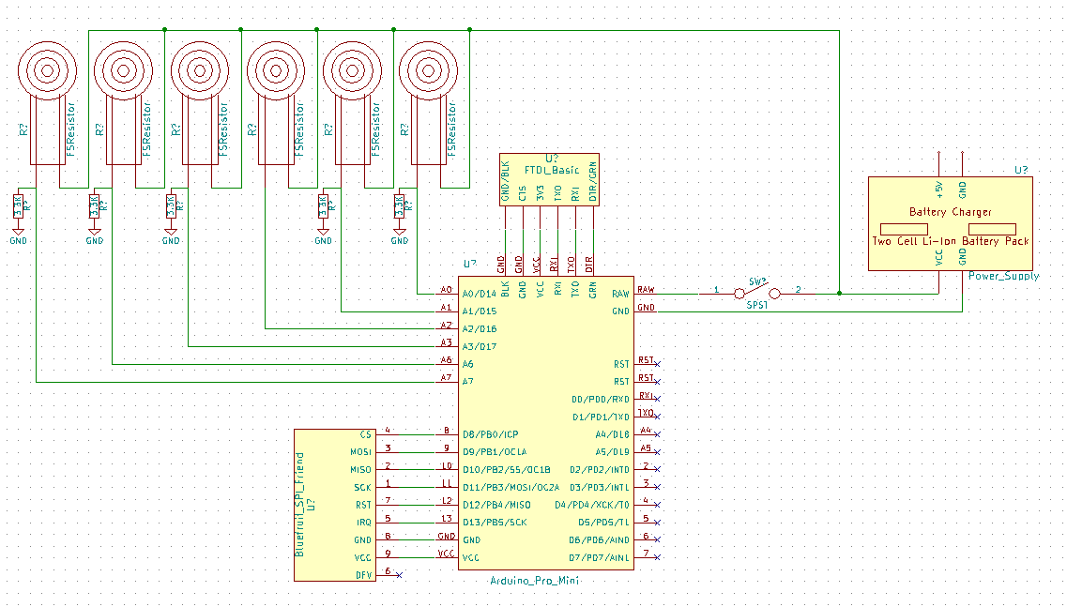
Circuit Diagram

Slide 11
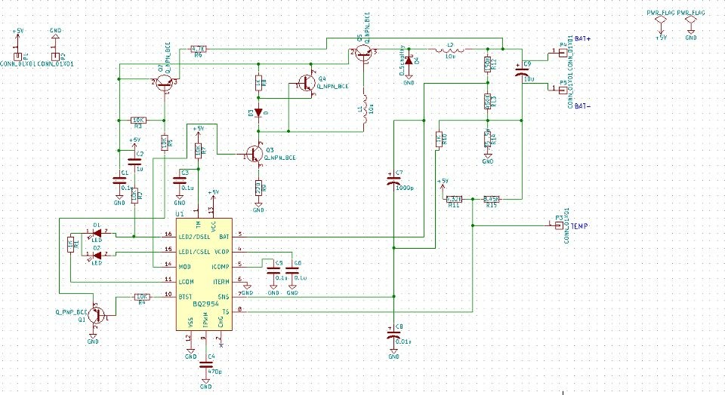
Charging Circuit diagram

Slide 12
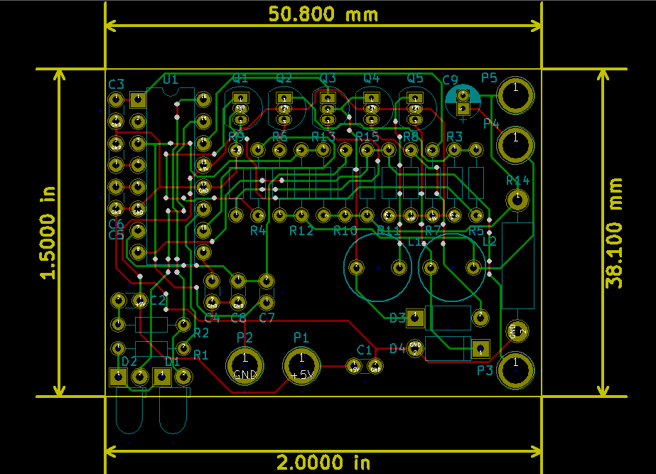
Charging circuit PCB layout

Slide 13
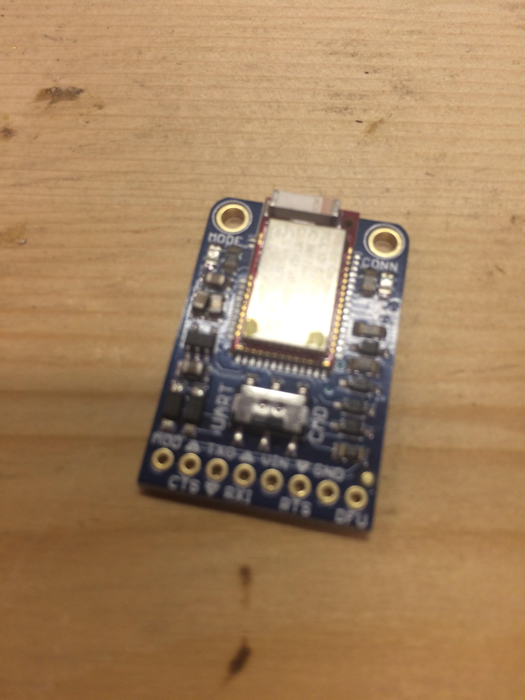
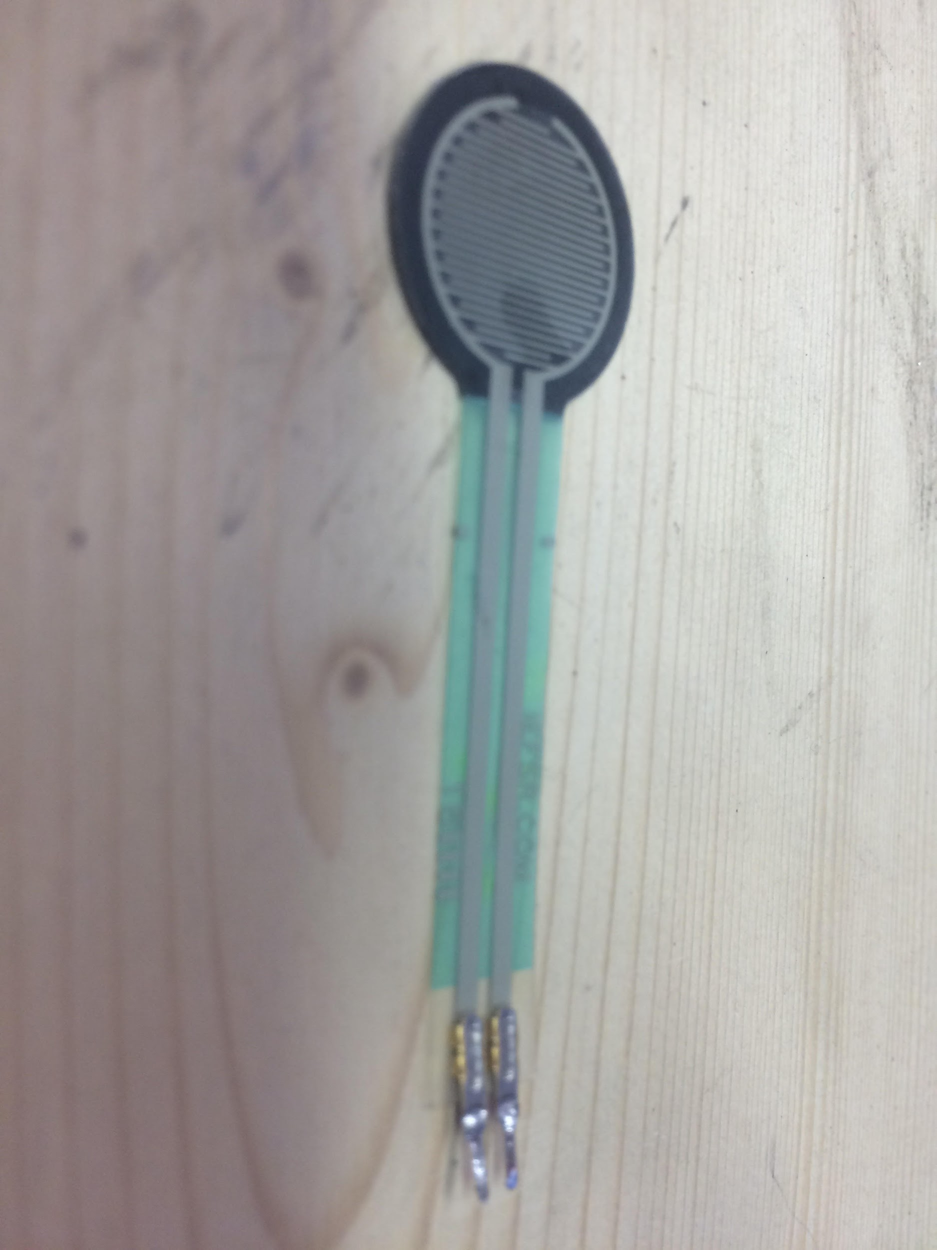
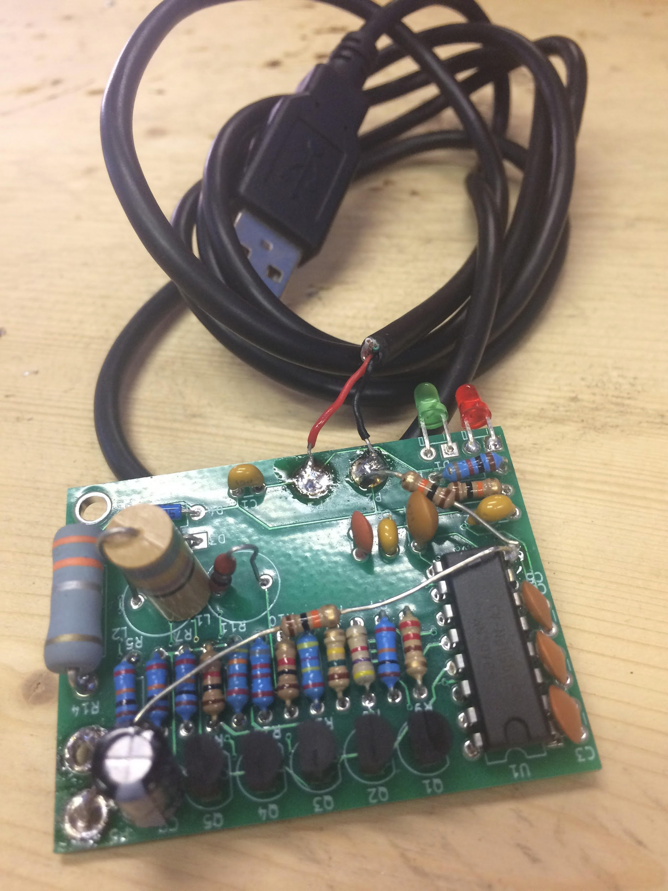
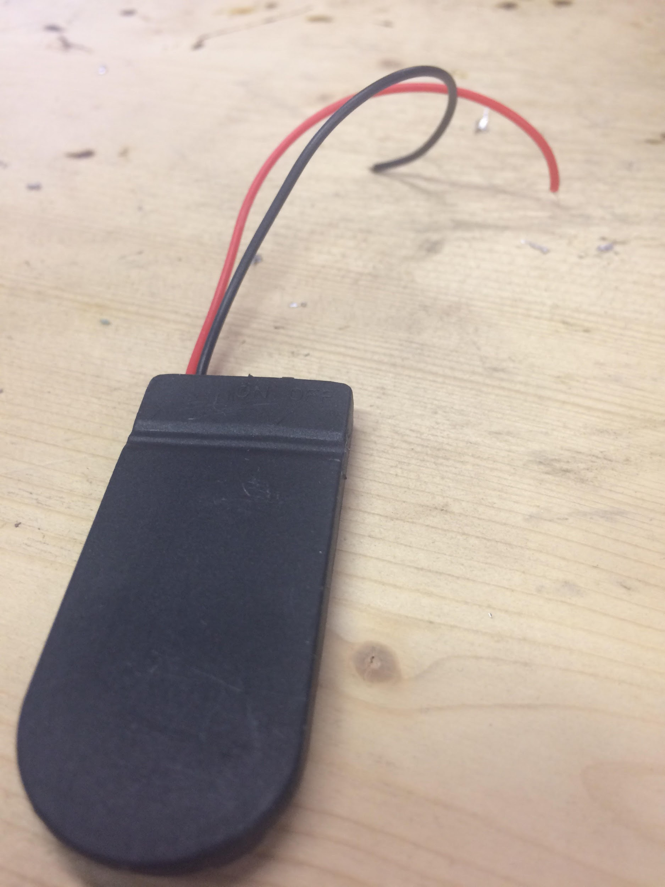
Components in shoe

Slide 14
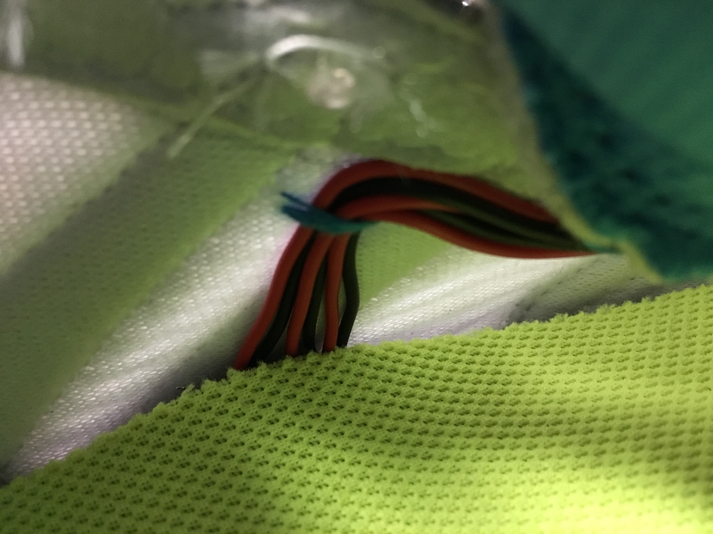
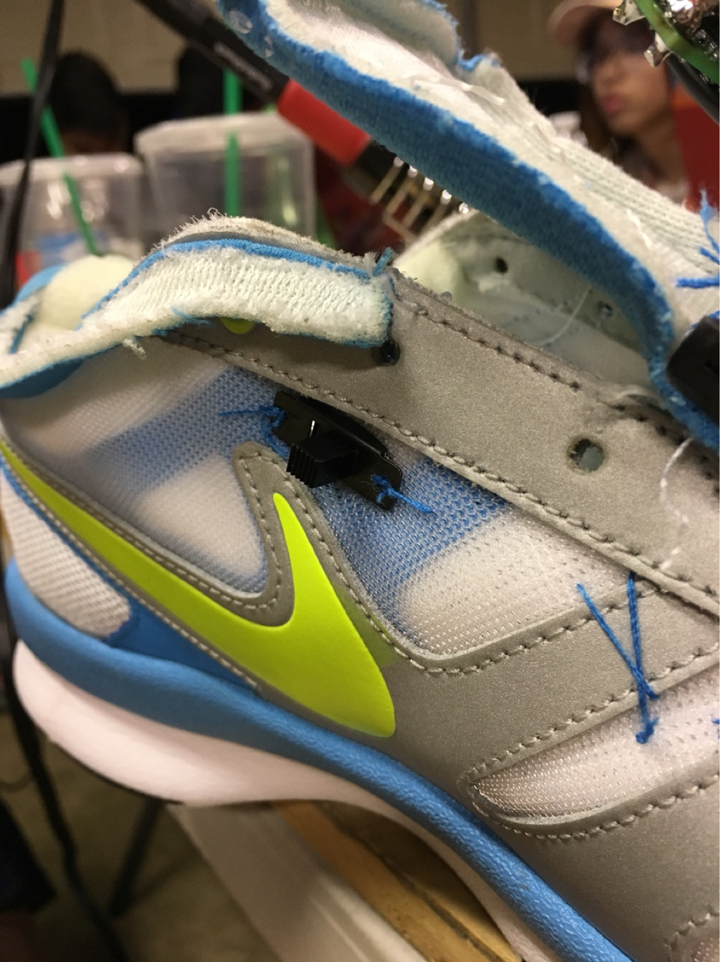
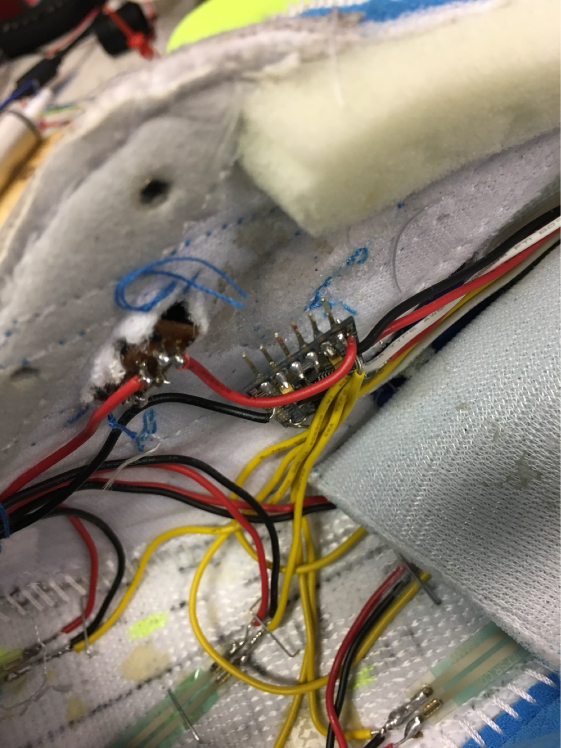
Process of making the shoe

Slide 15
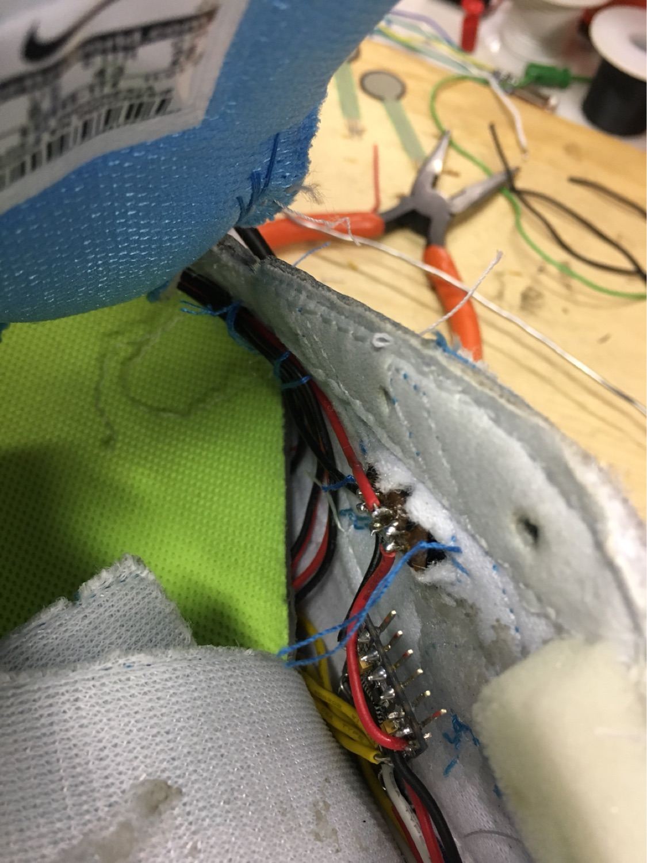
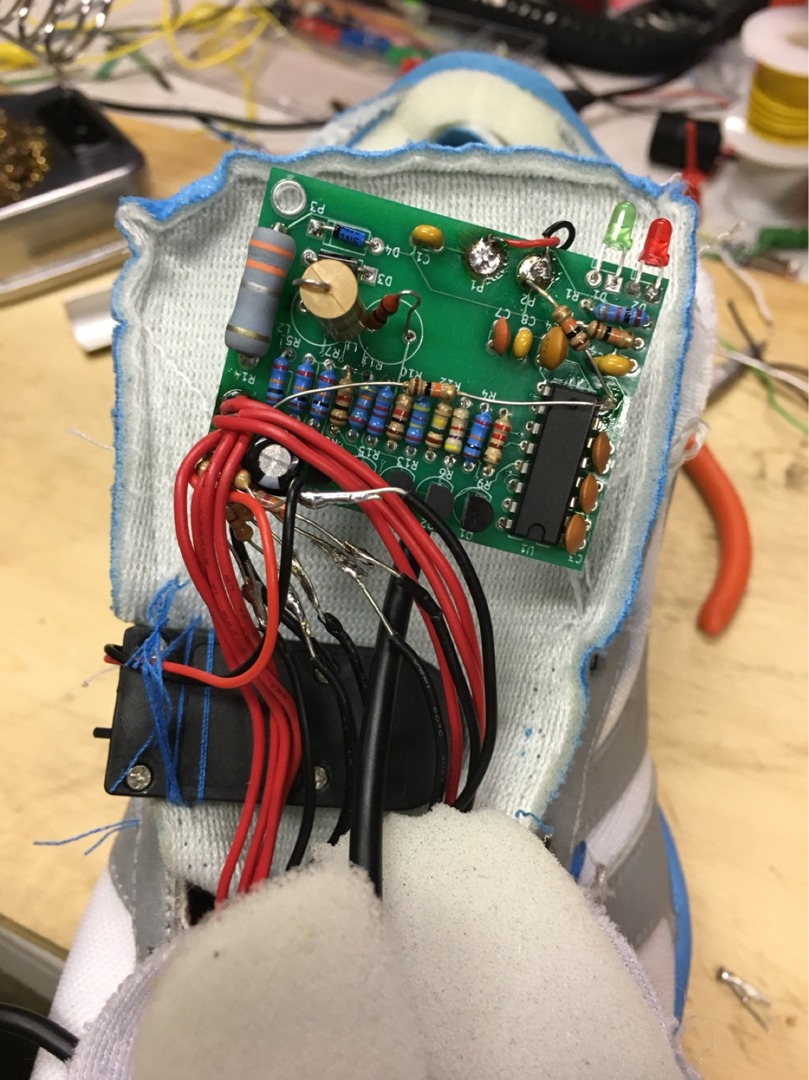
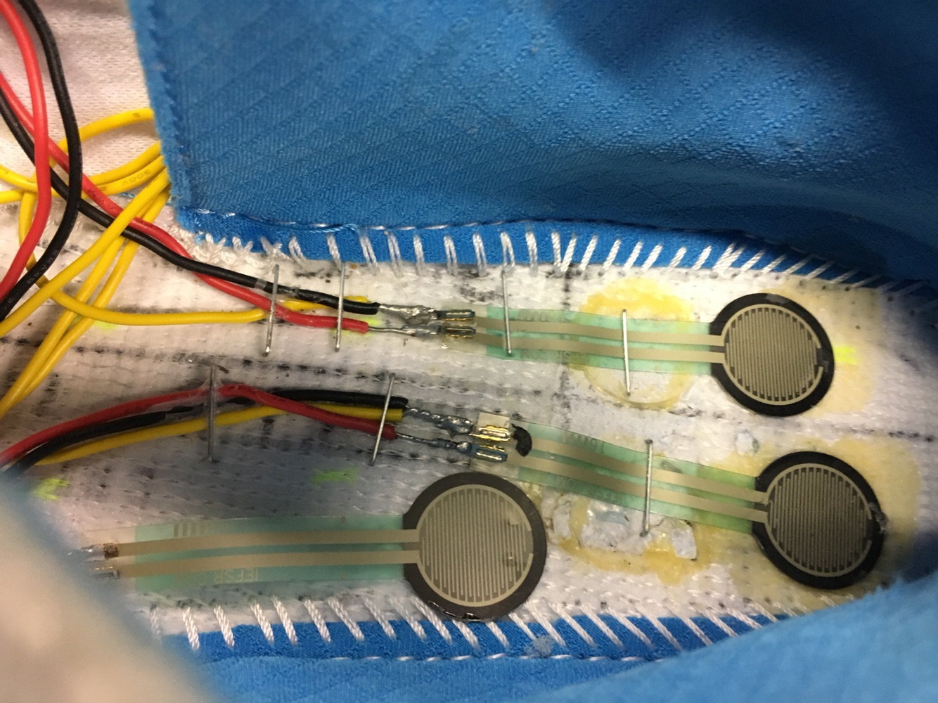
Process of making the shoe

Slide 16
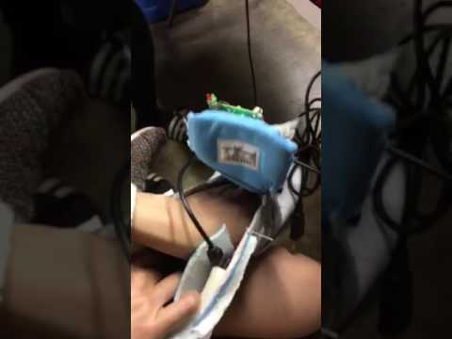
Some Data Readings

Slide 17
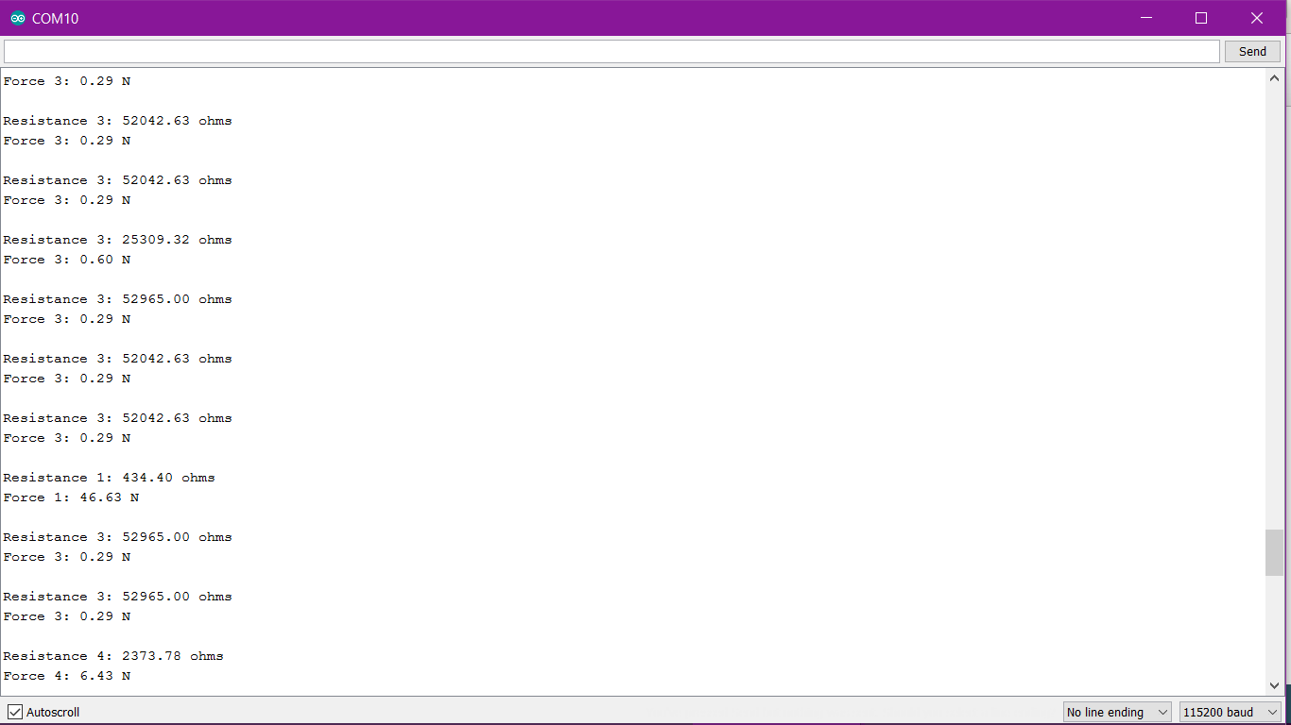
Some Data Readings

Slide 18
Prototype 2 goal
Better sensors
More sensor coverage
Weather resistant
Fall Detection Alarm system

Slide 19
Investment part
-Hermes Smart shoe $399.99
-Equity for how much to start the company? 10% equity for $400,000

Slide 20
Hermes’ Vision- Global scale
Initial office

Slide 21
Competitive Advantages
Low price
Simplicity
User - friendly technology
Customizable shoe
Rechargeable

Slide 22
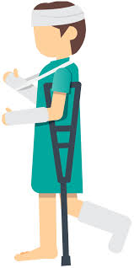



Target Customer and Market
Patients, insurance companies, physicians, rehab/therapy centers

Slide 23
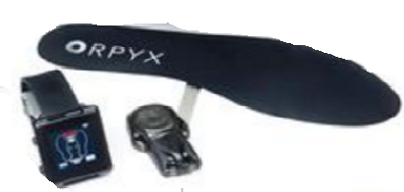
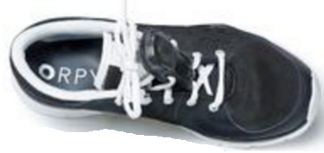
Competitors and their patents- Orpyx
-SurroSense Rx system - aid patients with diabetic peripheral neuropathy ; comes with smartwatch provides that real-time alerts when dangerous levels of pressure and all data is uploaded to cloud
-SurroGait Rx system- prevent falls , aid patients gait;
comprised of back sensors and foot sensors

Slide 24
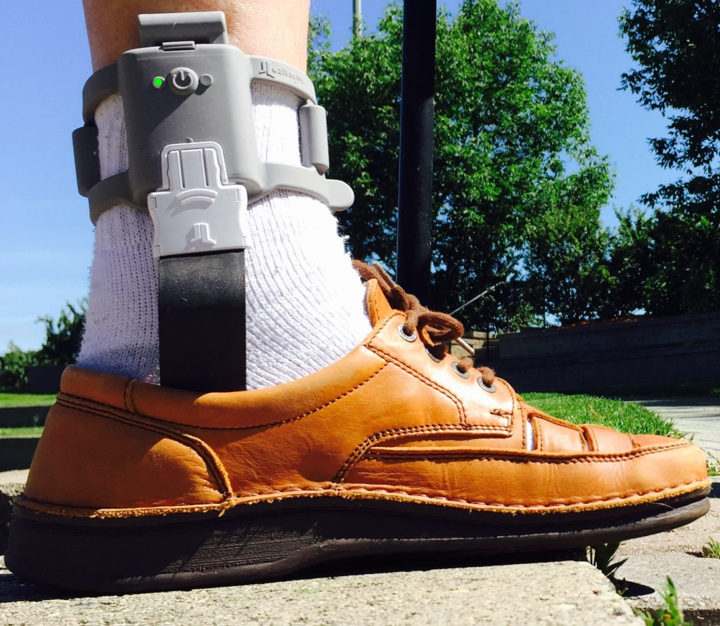
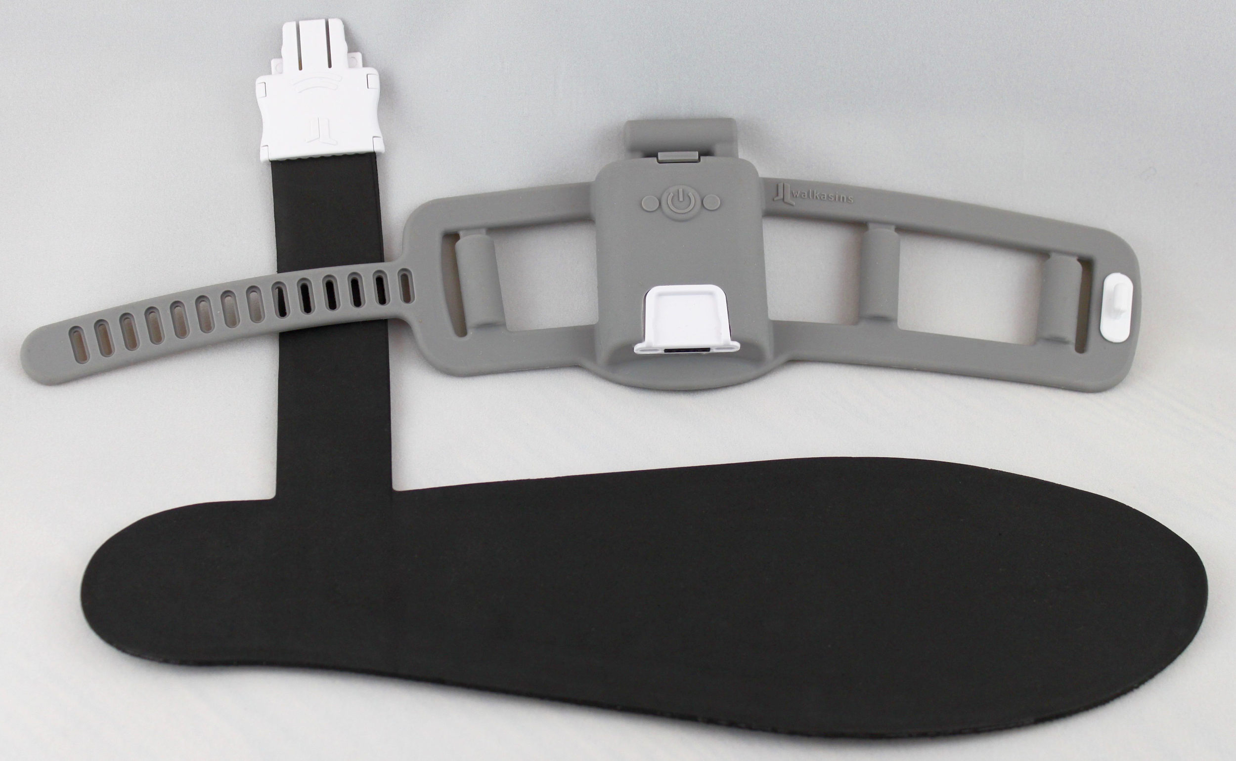
RxFunction - Walkasins
Developed for individuals with Peripheral neuropathy who have Balance problems
Pressure sensors information is transferred to multiple vibrating actuators. Tactile cues are sent to the wearer through the device strapped around the ankle to be interpreted as a new balance sense.
Patent Protected Technology

Slide 25
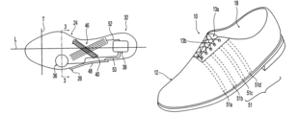
Patents similar to our product
-Disorders of asymmetries and/or imbalances in gait have been associated with significant clinical morbidity
-To assess symmetry imbalance

Slide 26
We love it when you brag about us so help us spread the word!
Place your order today!

Slide 27
Thanks!
Any questions, comments or concerns?

